Slide 1


Arzu Taghiyeva
16.12.2022

Slide 2

Outline
Executive Summary
Introduction
Methodology
Results
Conclusion
Appendix

Slide 3
Executive Summary
Summary of methodologies
Data Collection through API
Data Collection with Web Scraping
Data Wrangling
Exploratory Data Analysis with SQL
Exploratory Data Analysis with Data Visualization
Interactive Visual Analytics with Folium
Machine Learning Prediction
Summary of all results
Exploratory Data Analysis result
Interactive analytics in screenshots
Predictive Analytics result

Slide 4
Introduction
Project background and context
Space X advertises Falcon 9 rocket launches on its website with a cost of 62 million dollars; other providers cost upward of 165 million dollars each, much of the savings is because Space X can reuse the first stage. Therefore, if we can determine if the first stage will land, we can determine the cost of a launch. This information can be used if an alternate company wants to bid against space X for a rocket launch. This goal of the project is to create a machine learning pipeline to predict if the first stage will land successfully.
Problems you want to find answers
Identify the factors that influence rocket will land successfully.
Relationship between features and effects on the success rate of a successful landing.
What operating conditions needs to be in place to ensure a successful landing program.

Slide 5

Section 1

Slide 6
Methodology
Executive Summary
Data collection methodology:
Data was collected using SpaceX API and web scraping from Wikipedia.
Perform data wrangling
Data was processed using one-hot encoding for categorical features
Perform exploratory data analysis (EDA) using visualization and SQL
Perform interactive visual analytics using Folium and Plotly Dash
Perform predictive analysis using classification models
Build, tune, evaluate classification models

Slide 7
Data Collection
Data sets were collected
from Space X API (https://api.spacexdata.com/v4/rockets/) and
from Wikipedia (https://en.wikipedia.org/wiki/List_of_Falcon/_9/_and_Falcon_Heavy_launches), using web scraping technics.

Slide 8
Data Collection – SpaceX API
Data Collection via API we used We used the get request to the SpaceX API to collect data, then decode response content as json and apply json_normalize method to convert json result into a dataframe. We then cleaned the data, checked for missing values and fill with whatever needed.
https://github.com/ArzuTagi/Capstone_Project/blob/main/jupyter_labs_spacex_data_collection_api_.ipynb
Get request for data using API
Use json normalize method to convert json result
into a dataframe
Clean data, check missing value and fill if needed

Slide 9
Data Collection - Scraping
For web scrapping, we will use the BeautifulSoup to extract the launch records as HTML table, parse the table and convert it to a pandas dataframe for further analysis
https://github.com/ArzuTagi/Capstone_Project/blob/main/jupyter_labs_webscraping.ipynb
Get request for Falcon 9 Launch for Wiki page url
Create BeautifulSoup from the HTML response
Extract all column name from HTML header

Slide 10
Data Wrangling
Data Wrangling is the process of cleaning and unifying messy and complex data sets for easy access and Exploratory Data Analysis (EDA).
Calculate number of launches at each sites
Create a landing outcome label from the outcome column
Calculate the number and occurrence of mission outcome per orbit type
https://github.com/ArzuTagi/Capstone_Project/blob/main/Data_Wrangling.ipynb

Slide 11
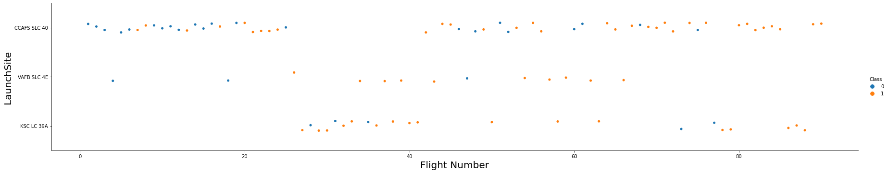
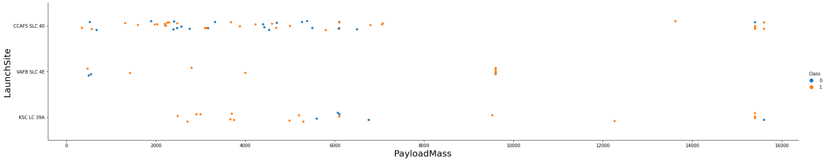
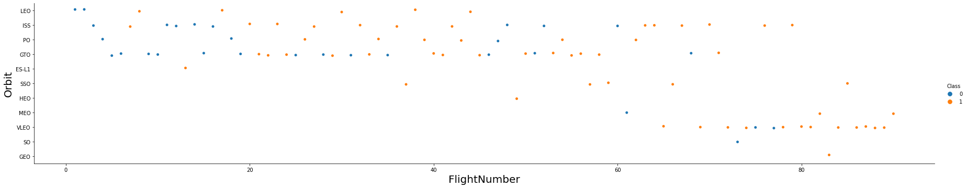
EDA with Data Visualization
Plot a scatter plot to find the relationship between the attributes such as between:
Payload and Flight Number.
Flight Number and Launch Site.
Payload and Launch Site.
Flight Number and Orbit Type.
Payload and Orbit Type.
https://github.com/ArzuTagi/Capstone_Project/blob/main/jupyter_labs_eda_dataviz_.ipynb

Slide 12
EDA with SQL
Using SQL, we performed following queries to get better understanding of the dataset:
Displaying the names of the launch sites.
Displaying 5 records where launch sites begin with the string ‘CCA’.
Displaying the total payload mass carried by booster launched by NASA (CRS).
Displaying the average payload mass carried by booster version F9 v1.1.
Listing the date when the first successful landing outcome in ground pad was achieved.
Listing the names of the boosters which have success in drone ship and have payload mass greater than 4000 but less than 6000.
Listing the total number of successful and failure mission outcomes.
Listing the names of the booster_versions which have carried the maximum payload mass.
Listing the failed landing_outcomes in drone ship, their booster versions, and launch sites names for in year 2015.
Rank the count of landing outcomes or success between the date 2010-06-04 and 2017-03-20, in descending order.
https://github.com/ArzuTagi/Capstone_Project/blob/main/jupyter_labs_eda_sql_coursera_sqllite.ipynb

Slide 13
Build an Interactive Map with Folium
We marked all launch sites on a map using site's latitude and longitude coordinates, create folium map object and added map objects such as markers, circles, lines to mark the success or failure of launches for each site on the folium map.
Launch outcomes for each site, and see which sites have high success rates. Recall that data frame spacex_df has detailed launch records, and the class column indicates if this launch was successful or not. Using the color-labeled marker clusters, we identified which launch sites have relatively high success rate.
Calculate the distances between a launch site to its proximities
https://github.com/ArzuTagi/Capstone_Project/blob/main/lab_jupyter_launch_site_location%20(2).ipynb

Slide 14
Build a Dashboard with Plotly Dash
We built an interactive dashboard with Plotly dash
We plotted pie charts showing the total launches by a certain sites
We plotted scatter graph showing the relationship with Outcome and Payload Mass (Kg) for the different booster version.

Slide 15
Predictive Analysis (Classification)
Build the model
Evaluate the model
Improve the modell
Find the best model
https://github.com/ArzuTagi/Capstone_Project/blob/main/SpaceX_Machine_Learning_Prediction_Part_5.ipynb

Slide 16
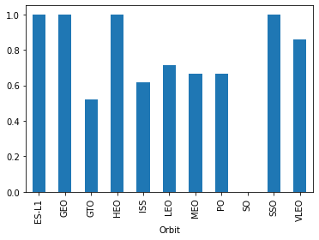
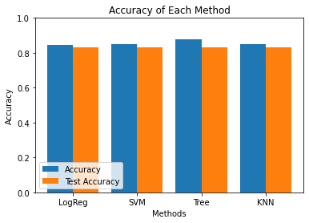
Results
Exploratory data analysis results
Interactive analytics demo in screenshots
Predictive analysis results

Slide 17

Section 2

Slide 18
Flight Number vs. Launch Site
We found out that when the flight number increase then the success number increase

Slide 19
Payload vs. Launch Site
The greater pay load mass the higher success rate

Slide 20
Success Rate vs. Orbit Type
From the bar chat, we can see that ES-L1, GEO, HEO, SSO, VLEO had the highest success rate, but about SO we can say that had no success

Slide 21
Flight Number vs. Orbit Type
Plot illustrates that in the LEO orbit, success is related to the number of flights whereas in the GTO orbit, there is no relationship between flight number and the orbit.

Slide 22
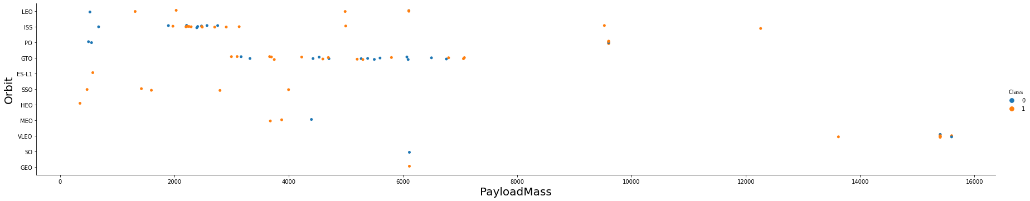
Payload vs. Orbit Type
We observe that heavier payloads have a positive impact on LEO, ISS orbits, but it has a negative impact on MEO and SO orbits. GTO orbit has no relationship.

Slide 23
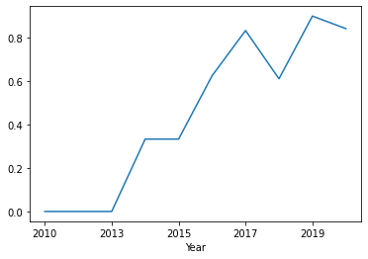
Launch Success Yearly Trend
We can observe that the sucess rate since 2013 kept increasing till 2020

Slide 24
All Launch Site Names
sql SELECT DISTINCT LAUNCH_SITE FROM SPACEXTBL ORDER BY 1;
Launch_Site
CCAFS LC-40
CCAFS SLC-40
KSC LC-39A
VAFB SLC-4E

Slide 25
Launch Site Names Begin with 'CCA'
sql SELECT * FROM SPACEXTBL WHERE LAUNCH_SITE LIKE 'CCA%' LIMIT 5;
Date | Time (UTC) | Booster_Version | Launch_Site | Payload | PAYLOAD_MASS__KG_ | Orbit | Customer | Mission_Outcome | Landing _Outcome
04-06-2010 | 18:45:00 | F9 v1.0 B0003 | CCAFS LC-40 | Dragon Spacecraft Qualification Unit | 0 | LEO | SpaceX | Success | Failure (parachute)
08-12-2010 | 15:43:00 | F9 v1.0 B0004 | CCAFS LC-40 | Dragon demo flight C1, two CubeSats, barrel of Brouere cheese | 0 | LEO (ISS) | NASA (COTS) NRO | Success | Failure (parachute)
22-05-2012 | 07:44:00 | F9 v1.0 B0005 | CCAFS LC-40 | Dragon demo flight C2 | 525 | LEO (ISS) | NASA (COTS) | Success | No attempt
08-10-2012 | 00:35:00 | F9 v1.0 B0006 | CCAFS LC-40 | SpaceX CRS-1 | 500 | LEO (ISS) | NASA (CRS) | Success | No attempt
01-03-2013 | 15:10:00 | F9 v1.0 B0007 | CCAFS LC-40 | SpaceX CRS-2 | 677 | LEO (ISS) | NASA (CRS) | Success | No attempt

Slide 26
Total Payload Mass
sql SELECT SUM(PAYLOAD_MASS__KG_) AS TOTAL_PAYLOAD FROM SPACEXTBL WHERE PAYLOAD LIKE '%CRS%';
TOTAL_PAYLOAD
111268

Slide 27
Average Payload Mass by F9 v1.1
sql SELECT AVG(PAYLOAD_MASS__KG_) AS AVG_PAYLOAD FROM SPACEXTBL WHERE BOOSTER_VERSION = 'F9 v1.1';
AVG_PAYLOAD
2928.4

Slide 28
First Successful Ground Landing Date
sql SELECT MIN(DATE) AS FIRST_SUCCESS_GP FROM SPACEXTBL
WHERE LANDING__OUTCOME = 'Success (ground pad)';
first_success_gp
2015-12-22

Slide 29
Successful Drone Ship Landing with Payload between 4000 and 6000
sql SELECT DISTINCT BOOSTER_VERSION FROM SPACEXTBL
WHERE PAYLOAD_MASS__KG_ BETWEEN 4000 AND 6000 AND Landing__Outcome = 'Success (drone ship)';
booster_version
F9 FT B1021.2
F9 FT B1031.2
F9 FT B1022
F9 FT B1026

Slide 30
Total Number of Successful and Failure Mission Outcomes
sql SELECT MISSION_OUTCOME, COUNT(*) AS QTY FROM SPACEXTBL GROUP BY MISSION_OUTCOME ORDER BY MISSION_OUTCOME;
Mission_Outcome | QTY
Failure (in flight) | 1
Success | 98
Success | 1
Success (payload status unclear) | 1

Slide 31
Boosters Carried Maximum Payload
sql SELECT DISTINCT BOOSTER_VERSION FROM SPACEXTBL
WHERE PAYLOAD_MASS__KG_ = (SELECT MAX(PAYLOAD_MASS__KG_) FROM SPACEXTBL)
ORDER BY BOOSTER_VERSION;
Booster_Version
F9 B5 B1048.4
F9 B5 B1048.5
F9 B5 B1049.4
F9 B5 B1049.5
F9 B5 B1049.7
F9 B5 B1051.3
F9 B5 B1051.4
F9 B5 B1051.6
F9 B5 B1056.4
F9 B5 B1058.3
F9 B5 B1060.2
F9 B5 B1060.3

Slide 32
2015 Launch Records
sql SELECT BOOSTER_VERSION, LAUNCH_SITE FROM SPACEXTB
WHERE LANDING__OUTCOME = 'Failure (drone ship)' AND
DATE_PART('YEAR', DATE) = 2015;
booster_version | launch_site
F9 v1.1 B1012 | CCAFS LC-40
F9 v1.1 B1015 | CCAFS LC-40

Slide 33
Rank Landing Outcomes Between 2010-06-04 and 2017-03-20
sql SELECT LANDING__OUTCOME, COUNT(*) AS QTY FROM SPACEXTBL
WHERE DATE BETWEEN '2010-06-04' AND
'2017-03-20' GROUP BY LANDING__OUTCOME ORDER BY QTY DESC;
landing__outcome | qty
No attempt | 10
Failure (drone ship) | 5
Success (drone ship) | 5
Controlled (ocean) | 3
Success (ground pad) | 3
Failure (parachute) | 2
Uncontrolled (ocean) | 2
Precluded (drone ship) | 1

Slide 34

Section 3

Slide 35
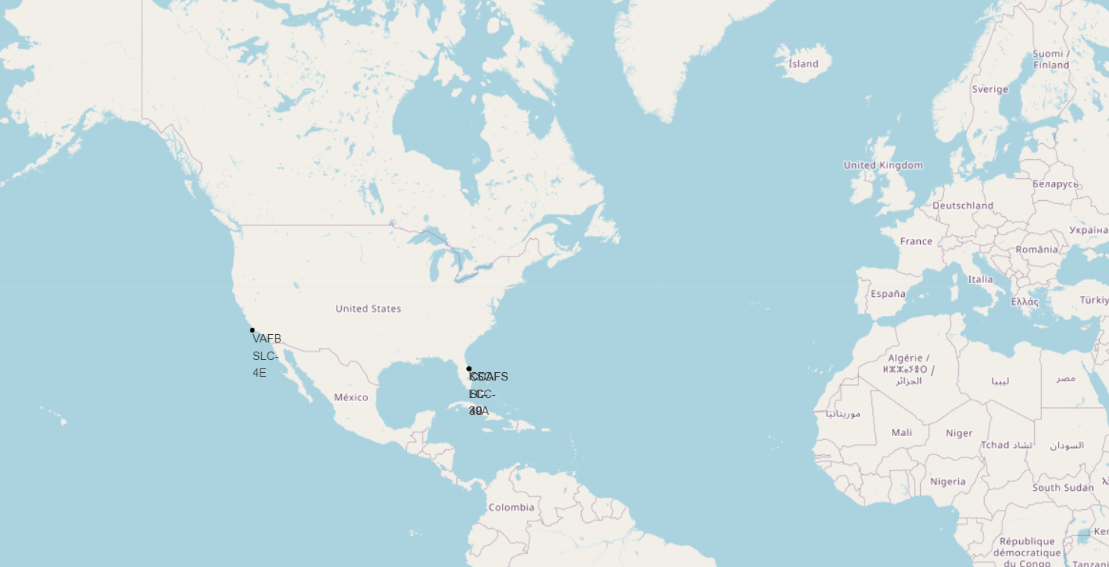
All launch sites
We can see that all the SpaceX launch sites are located inside the United States

Slide 36

Mark the success/failed launches for each site on the map

Slide 37

Distances between a launch site to its proximities

Slide 38

Section 4

Slide 39
Success Launches By Site
KSC LC -39A had the most sussessful launch, but CCAFS LC-40 had the least

Slide 40

Launch site with the highest launch success ratio
KSC LC-39A had 76.9% success rate

Slide 41
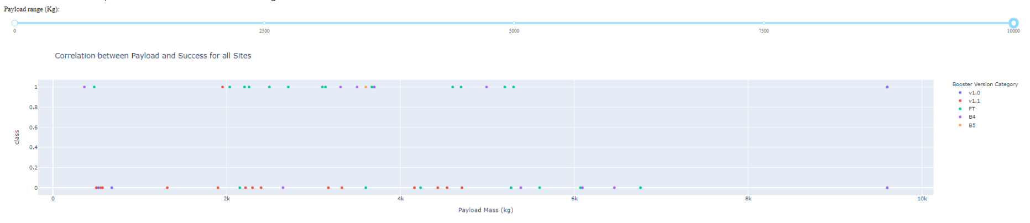
Payload vs Launch Outcome Scatter Plot
Success rate for low weighted payloads is higher than heavy weighted payloads

Slide 42

Section 5

Slide 43
Classification Accuracy
According to the below bar chart we can say that the model with the highest classification accuracy is Decision Tree Classifier

Slide 44
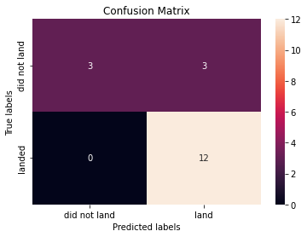
Confusion Matrix
The confusion matrix for the decision tree classifier shows that the classifier can distinguish between the different classes. The major problem is the false positives .i.e., unsuccessful landing marked as successful landing by the classifier.

Slide 45
Conclusions
We conclude that:
When the flight number increase then the success number increase
The greater pay load mass the higher success rate
Sucess rate since 2013 kept increasing till 2020
Orbits ES-L1, GEO, HEO, SSO, VLEO had the most success rate
The best launch site is KSC LC-39A
The Decision tree classifier is the best machine learning algorithm for this task.

Slide 46
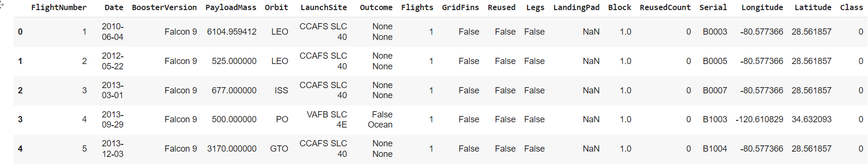
Appendix

Slide 47


